Slide 1

Cost-cutting and Filling of posts
KwaZulu-Natal
Provincial Treasury
07 June 2018

Slide 2
Circular PT (3) of 2018/19 (1)
  As per the 2018/19 Budget speech “…despite the encouraging economic outlook, the country’s financial position is still under severe pressure, demanding that we make tough decisions. As stated by the former Minister of Finance last month, Honorable Malusi Gigaba, while tabling the national budget, I quote, “The fiscal proposals will cause discomfort, but they are necessary to protect the integrity of the public finances.””
  “The cost-cutting measures remain in place. The provincial cost-cutting measures and those issued by National Treasury must continue to be adhered to. Every little saving helps us to protect service delivery spending in these times of continuous budget cuts. To quote an African proverb “If you think you are too small to make a difference, you haven’t spent a night with a mosquito.””
  IMPLEMENTATION of Circular PT (3) of 2018/19 is therefore important so that we maintain and enhance the fiscal austerity measures that were approved by the PEC (Cabinet) in October 2009 and enhanced/amended over the years. Some depts are slowly slipping back into bad habits and wastage

Slide 3
Circular PT (3) of 2018/19 (2)
  CHALLENGES
      Events – PT approval for ALL costs of events – including marquees, catering, security, accommodation, tables/chairs/decorations, transport, etc.
      PT approval to be sought 5 working days before the event is planned to take place – noted that there will be some last minute approvals, but must be the exception. This remains the area of most concern at present – depts. are not meeting this deadline!! Now known in PT as #lastminute.com events – the only exceptions likely to receive approval for late submission are funerals and emergency meetings/events such as in a Xenophobia outbreak or natural disaster.
      Proposal – as soon as submission begins its movement from author to HOD – send a copy to SCM to get quotes – don’t wait until HOD has approved. Also, HODs and CGOs need to see real (not estimated) costs before signing. Too often submissions are received on time but quotes come either a day before or even after the event. PT will NOT approve the event if quotes are late.

Slide 4
Challenges (2)
  Reiterating that event requests are not reaching PT 5 days or more prior to the day of the event
  Often no or incomplete quotes are submitted – must be 3 quotes for each service/item
  If accommodation is not being procured centrally (ie. regions or district are booking) – then to avoid delays and multiple quotes just cost the total number needing accommodation at R1 400 per night with a proviso that if costs exceed this by more than 10% then the request will be resubmitted
  Many sources of event requests within depts – proposal is that depts. use 1 central controlling point if possible – Health use Communications Unit and Soc. Dev. uses SCM Unit
  PT has designed a checklist of activities for event submissions – on the CD for depts. to use/adapt for their own processes and submit with event requests

Slide 5
Challenges (3)
  Many events are annual or listed in the APP – yet event requests arrive late – evidence of poor planning
  Question – are depts. monitoring that no S&T claims are processed for staff at catered events?

Slide 6
International Travel
  Depts are reminded that ALL costs need to be included for approval in international travel requests – flights, taxes, transit costs, accommodation, car hire, S&T, etc. Please also list full cost not cost per day!
  Para 28 “Business class travel only for MECs, HODs, CEOs, Chairs of Board (and MPLs, where applicable). All other officials and board members must fly economy class” – this is more stringent than NT Instruction 4 of 17/18 and overrides the NT requirements – do NOT cite the NT document as motivation for deviating from the above!

Slide 7
Conclusion
      Remember, the economy is only growing marginally – this will have a limiting effect on tax revenues and hence on available funding for government spending – possibility of further cuts?? – and any cuts at dept level are likely to be proportionate to your share of the total provincial budget
      PT, as part of IYM process, reviews depts’ inputs with emphasis on those items that should be showing savings if cost-cutting measures are being implemented. These would be areas that would be “targeted” when implementing budget cuts
      So cost-cutting is essential to maintain our current levels of service to our people

Slide 8

PROCESS OF FILLING CRITICAL VACANT POSTS IN THE PROVINCE OF KWAZULU-NATAL
PRESENTATION AT THE KZN PROVINCIAL TREASURY GUIDELINE WORKSHOP
KZN OFFICE OF THE PREMIER
CHIEF DIRECTORATE: STRATEGIC HUMAN RESOURCE MANAGEMENT
Presented by:
Date: 7 June 2018

Slide 9

Analysis of submissions Approved as at 4 June 2018

Slide 10
Analysis of submissions Approved as at 4 June 2018

Slide 11
Analysis of submissions Returned / Not Approved as at 4 June 2018

Slide 12
Analysis of submissions Returned / Not Approved as at 4 June 2018

Slide 13
Analysis of submissions still going through the process as at 4 June 2018

Slide 14
Analysis of submissions still going through the process as at 4 June 2018

Slide 15
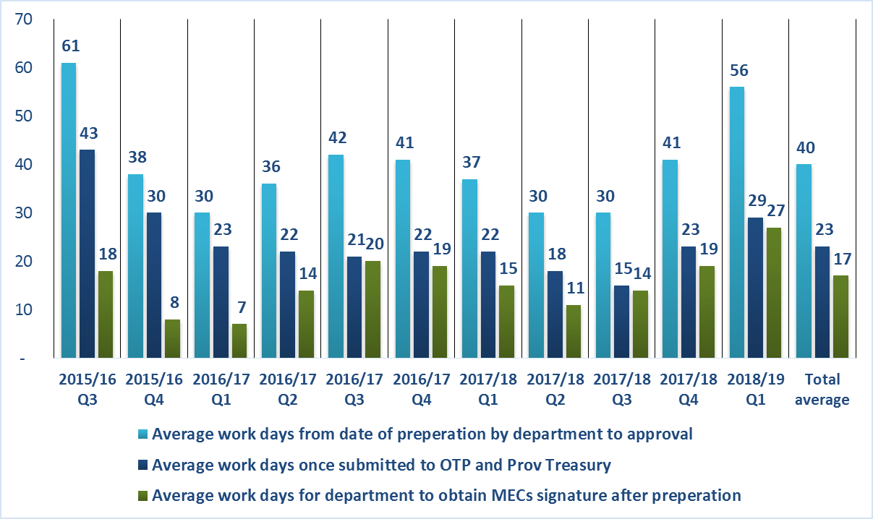
Analysis of time taken to process submissions as at 4 June 2018

Slide 16
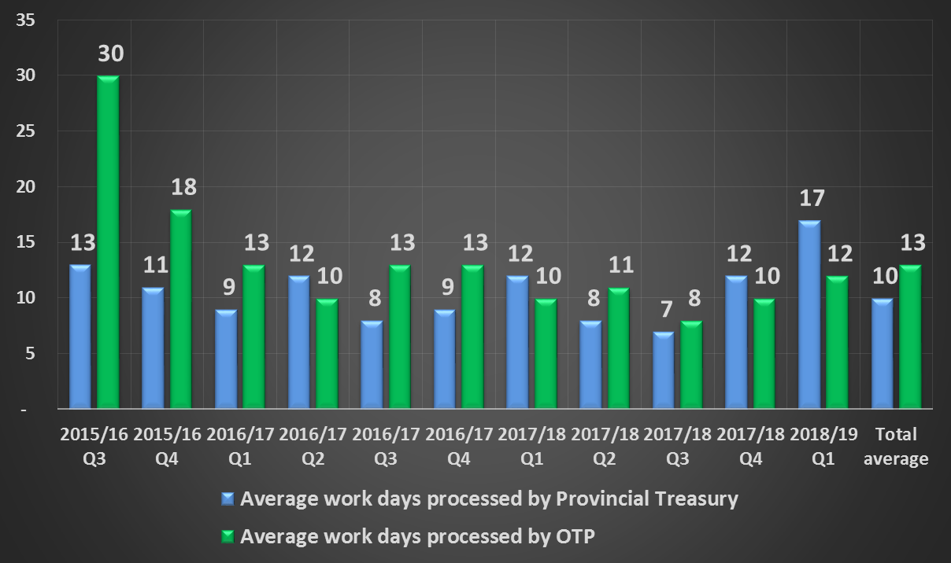
Average days to process for Office of the Premier and Provincial Treasury as at 4 June 2018

Slide 17
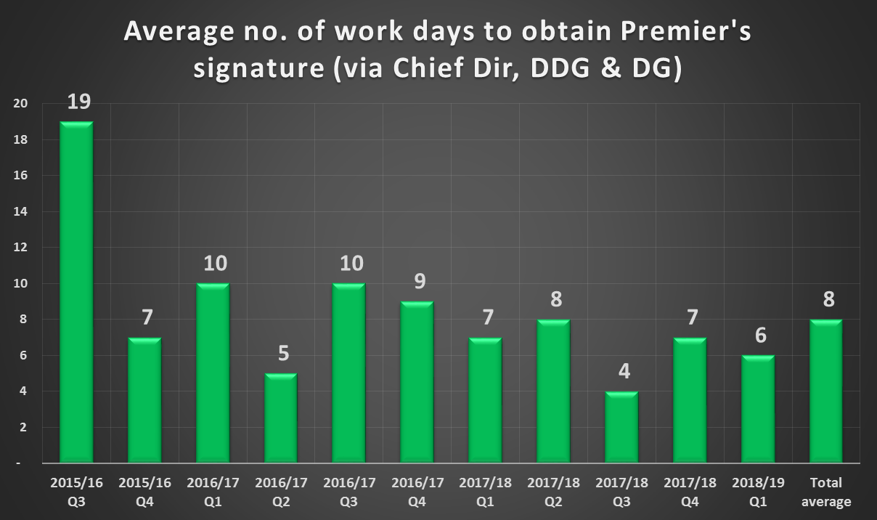

Slide 18
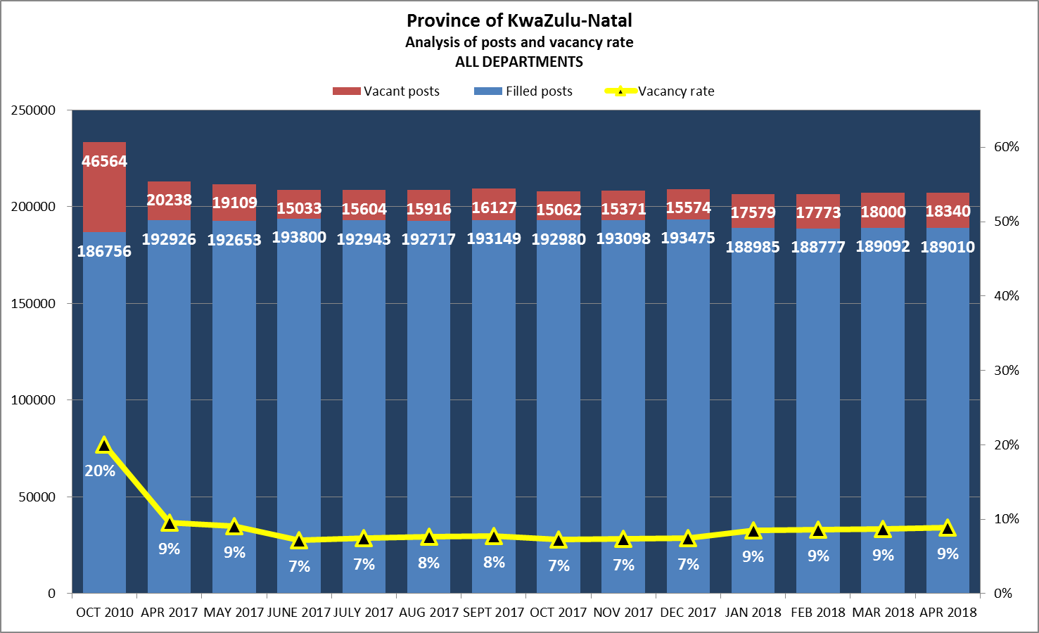

Slide 19
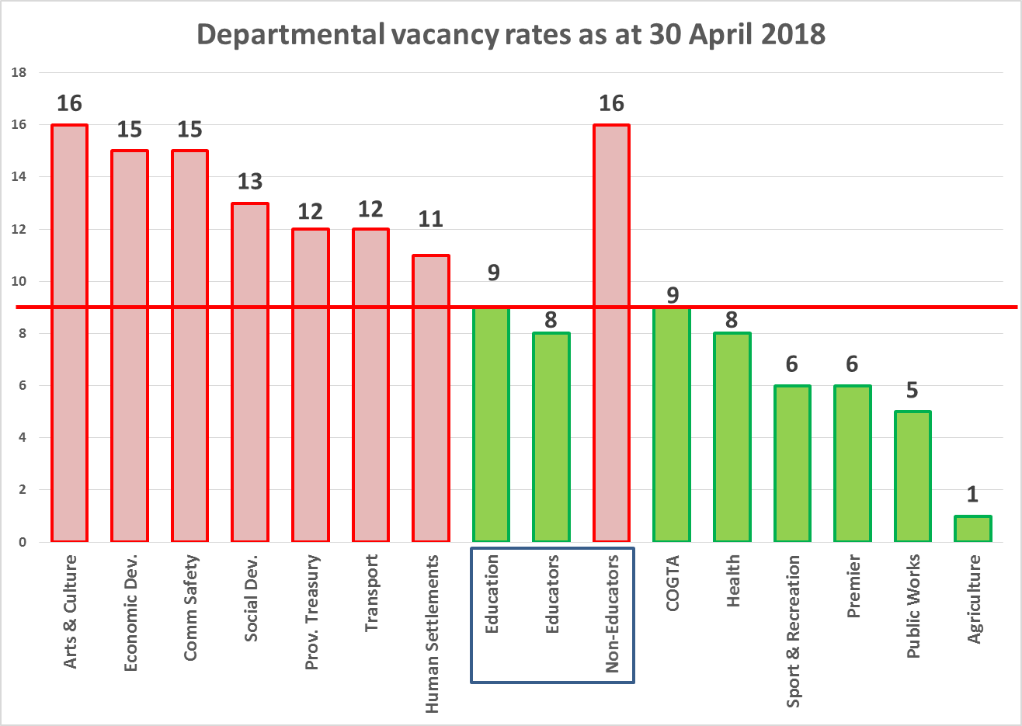

Slide 20
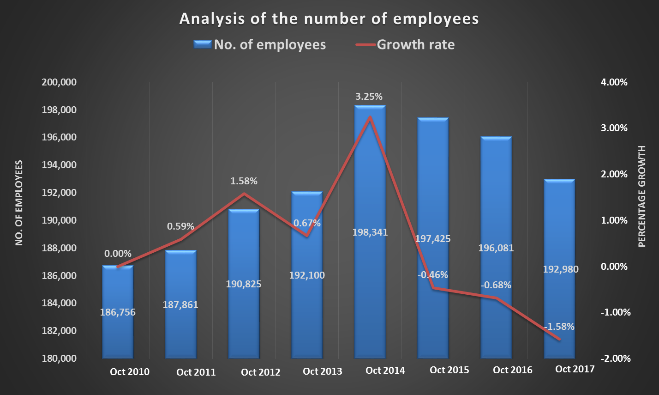
Impact of the intervention
It is evident from the statistics that the intervention is having an impact in that the number of employees in the Province is no longer increasing annually, it is decreasing.

Slide 21
Points to note
PT does not submit a request to OTP if funding is an issue

Slide 22
Points to note
Revised organograms – note that PT will not approve any funding for expanded organograms – if a PT certificate is needed for DPSA then it can be given but without funding – which means depts. will only be able to fill new posts when funding is reprioritised….
If approval for a post was given more than 1 year ago and the post is still not filled then this post needs a new approval process – this is a proposal to be sent to COHOD for approval!!
Some depts. are requesting approval for contract appointments while recruitment processes are underway – this is OK but PT will not extend these contracts unless there are extenuating circumstances – recently refused extension when a dept took more than 8 months from approval of post/contract to interview stage – please ensure recruitment process moves quickly!!

Slide 23
Points to note
Contracts are dangerous – recent cases show continual extension of contract can result in depts. being forced to appoint incumbents as permanents – labour law supports the employee in this regard!!
Please consider batching or grouping requests for the unfreezing of posts – either monthly or quarterly. PT gets inundated with single requests which slows down the process…
There is not really a moratorium on filling posts – appointments are possible if post is critical and FUNDED!!

Slide 24
THE END
QUESTIONS / COMMENTS

Slide 25
Thank you

